Slide 1
Unit 05 Service Management in Cloud Computing & Cloud Security

Slide 2
Service Level Agreements (SLAs)
Enterprises developed the web applications and deployed on the infrastructure of the third-party service providers.
These providers get the required hardware and make it available for application hosting.
It necessitated the enterprises to enter into a legal agreement with the infrastructure service providers to guarantee a minimum quality of service (QoS).
Typically, the QoS parameters are related to the availability of the system CPU, data storage, and network for efficient execution of the application at peak loads. This legal agreement is known as the service-level agreement (SLA).

Slide 3
Service Level Agreements (SLAs)
For example, one SLA may state that the application’s server machine will be available for 99.9% of the key business hours of the application’s end users, also called core time, and 85% of the non-core time.
Another SLA may state that the service provider would respond to a reported issue in less than 10 minutes during the core time, but would respond in one hour during non-core time.
These SLAs are known as the infrastructure SLAs, and the infrastructure service providers are known as Application Service Providers (ASPs).

Slide 4
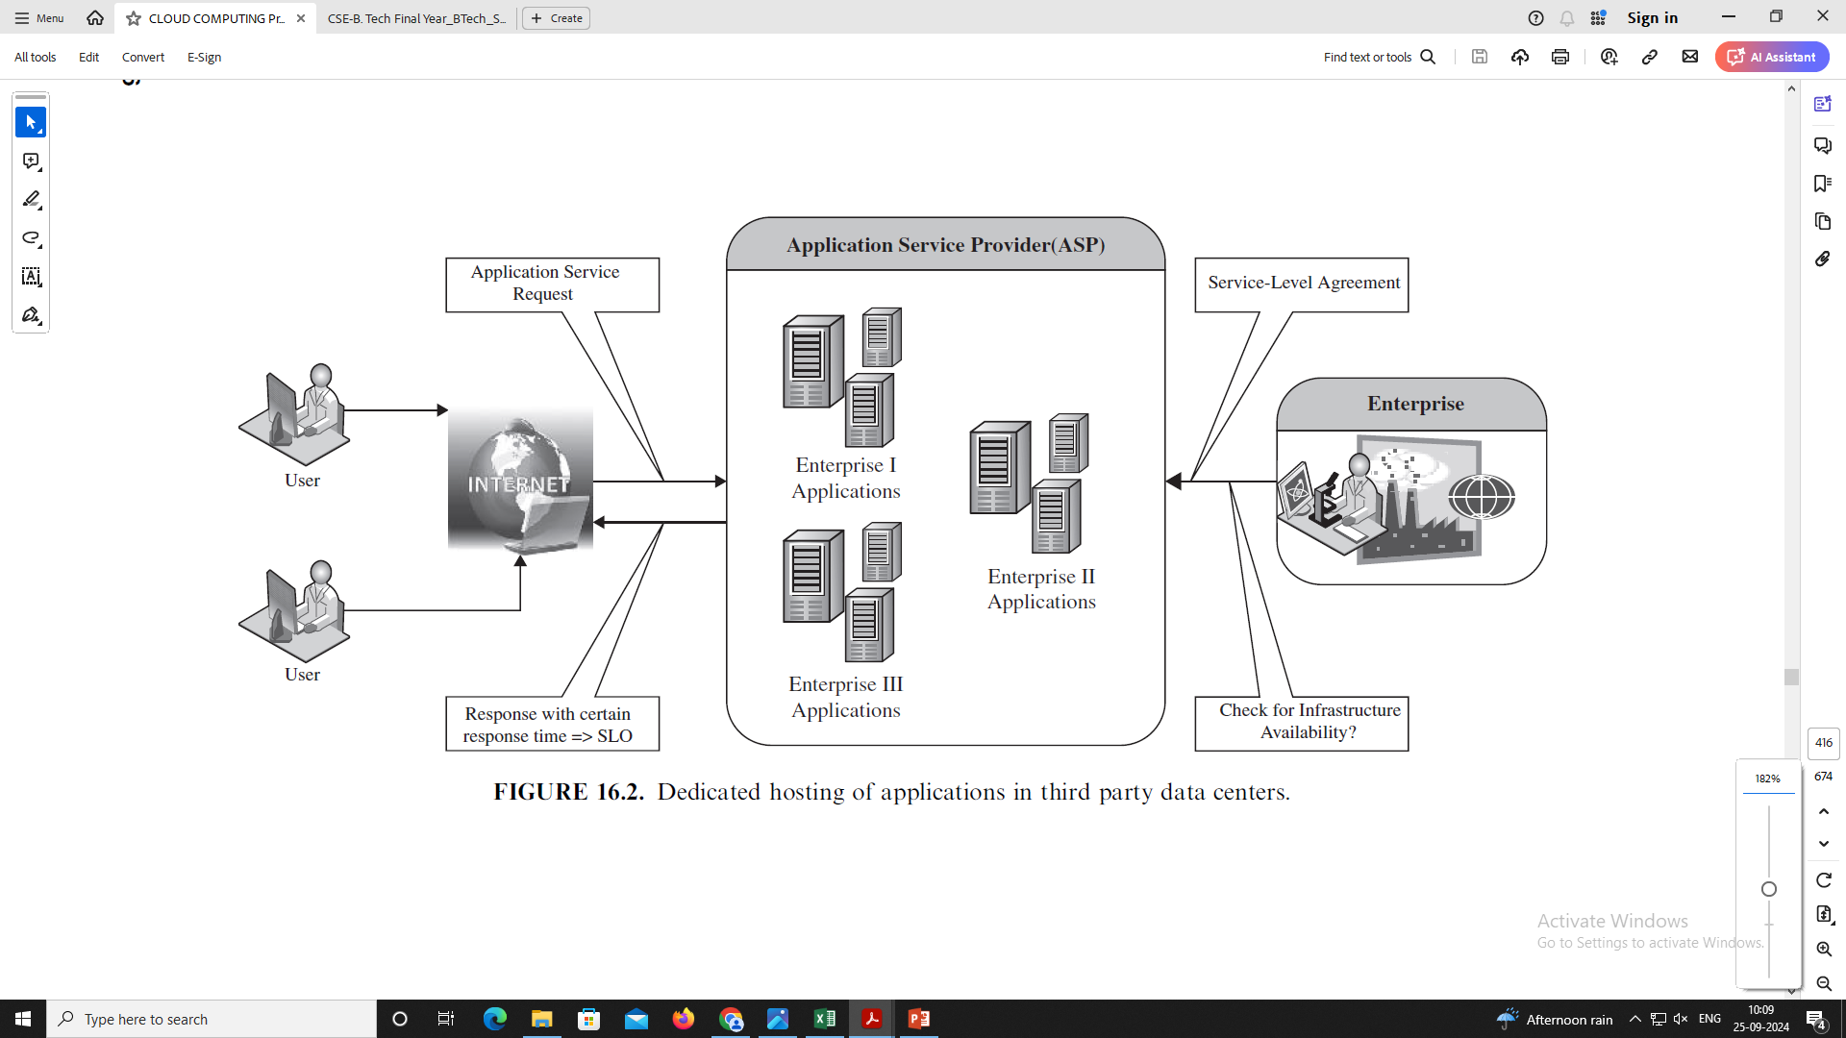
Service Level Agreements (SLAs)

Slide 5
Service Level Agreements (SLAs)
Traditionally, load balancing techniques and admission control mechanisms have been used to provide guaranteed quality of service (QoS) for hosted web applications.
These mechanisms can be viewed as the first attempt towards managing the SLOs (Service Level Objectives).

Slide 6
TYPES OF Service Level Agreements (SLAs)
Service-level agreement provides a framework within which both seller and buyer of a service can pursue a profitable service business relationship.
It outlines the broad understanding between the service provider and the service consumer for conducting business and forms the basis for maintaining a mutually beneficial relationship.
From a legal perspective, the necessary terms and conditions that bind the service provider to provide services continually to the service consumer are formally defined in SLA.

Slide 7
TYPES OF Service Level Agreements (SLAs)
SLA can be modeled using web service-level agreement (WSLA) language specification.
Although WSLA is intended for web-service-based applications, it is equally applicable for hosting of applications.
Service-level parameter, metric, function, measurement directive, service-level objective, and penalty are some of the important components of WSLA.

Slide 8
TYPES OF Service Level Agreements (SLAs)
There are two types of SLAs from the perspective of application hosting.
Infrastructure SLA:
The infrastructure provider manages and offers guarantees on availability of the infrastructure, namely, server machine, power, network connectivity, and so on.
Enterprises manage themselves, their applications that are deployed on these server machines.
The machines are leased to the customers and are isolated from machines of other customers.
In such dedicated hosting environments, a practical example of service-level guarantees offered by infrastructure providers.

Slide 9
TYPES OF Service Level Agreements (SLAs)
Application SLA:
In the application co-location hosting model, the server capacity is available to the applications based solely on their resource demands.
Hence, the service providers are flexible in allocating and de-allocating computing resources among the co-located applications.
Therefore, the service providers are also responsible for ensuring to meet their customer’s application SLOs.
For example, an enterprise can have the following application SLA with a service provider for one of its application.

Slide 10
TYPES OF Service Level Agreements (SLAs)
It is also possible for a customer and the service provider to mutually agree upon a set of SLAs with different performance and cost structure rather than a single SLA.
The customer has the flexibility to choose any of the agreed SLAs from the available offerings.
At runtime, the customer can switch between the different SLAs.

Slide 11
Challenges OF Service Level Agreements (SLAs)
The application is a black box to the Managed Service Providers (MSP) and the MSP has virtually no knowledge about the application runtime characteristics. Therefore, the MSP needs to determine the right amount of computing resources required for different components of an application at various workloads.
The MSP needs to understand the performance bottlenecks and the scalability of the application.
The MSP analyzes the application before it goes on-live. However, subsequent operations/enhancements by the customer’s to their applications or auto updates beside others can impact the performance of the applications, thereby making the application SLA at risk.
The risk of capacity planning is with the service provider instead of the customer. If every customer decides to select the highest grade of SLA simultaneously, there may not be a sufficient number of servers for provisioning and meeting the SLA obligations of all the customers.

Slide 12
LIFE CYCLE OF SLA
Each SLA goes through a sequence of steps starting from identification of terms and conditions, activation and monitoring of the stated terms and conditions, and eventual termination of contract once the hosting relationship ceases to exist.
Such a sequence of steps is called SLA life cycle and consists of the following five phases:
1. Contract definition
2. Publishing and discovery
3. Negotiation
4. Operationalization
5. De-commissioning

Slide 13
SLA MANAGEMENT IN CLOUD
SLA management of applications hosted on cloud platforms involves five phases.
1. Feasibility
2. On-boarding
3. Pre-production
4. Production
5. Termination

Slide 14
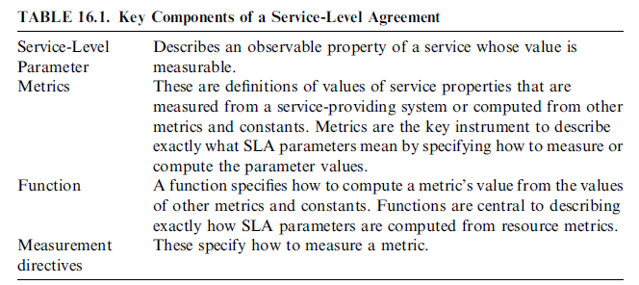
SLA

Slide 15
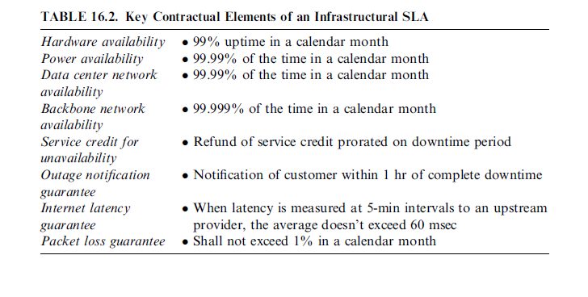
SLA

Slide 16
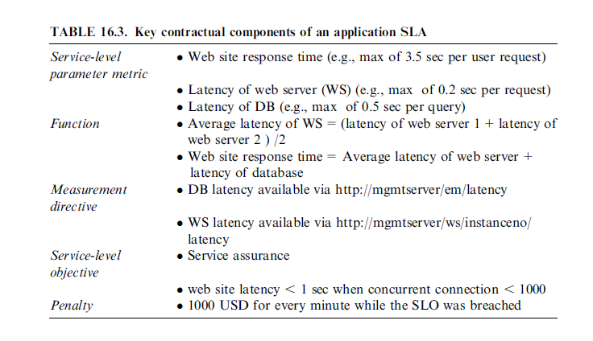
SLA

Slide 17
Service Level Agreements (SLAs)
A Service Level Agreement (SLA) is a formal contract between a service provider and a customer that outlines the expectations and responsibilities regarding the service offered.
Key Elements:
Uptime/Availability: Specifies the percentage of time the service will be available (e.g., 99.9% uptime).
Performance Metrics: Defines the expected performance in terms of response times, transaction rates, etc.
Support and Maintenance: Details how support is handled, including response times and maintenance windows.
Penalties and Remedies: Specifies compensations in case the service doesn’t meet agreed standards.
Importance: Provides a baseline for measuring service quality and ensures transparency between service providers and customers.

Slide 18
Billing & Accounting in Cloud Computing
Billing Models:
Pay-as-you-go: Customers are charged based on actual usage (e.g., compute hours, storage usage).
Subscription-based: Customers pay a fixed amount on a monthly/yearly basis for predetermined resources.
Key Components of Billing:
Resource Usage: Billing for compute power, storage, bandwidth, etc.
APIs and Services: Some providers charge based on the number of API calls or data processed through services.
Accounting: Tracks the use of cloud resources for accurate billing, monitoring, and management.
Tools: Many cloud providers offer tools to monitor and forecast spending, like AWS Cost Explorer or Azure Cost Management.

Slide 19
Comparing Scaling Hardware: Traditional vs. Cloud
Traditional Scaling:
Vertical Scaling (Scaling Up): Involves increasing the capacity of a single server (e.g., adding more CPU, memory).
Horizontal Scaling (Scaling Out): Adding more physical servers to handle the increased load.
Challenges: Requires upfront investment, capacity planning, hardware limitations, and difficulty in managing rapid scaling.
Cloud Scaling:
Elasticity: Cloud platforms enable dynamic scaling (both up and down) based on demand with minimal effort.
Horizontal Scaling in Cloud: Easier to implement; more servers can be automatically provisioned or decommissioned.
Cost Efficiency: No need for large upfront investments. Pay only for the resources used.

Slide 20
Economics of Scaling: Benefitting Enormously
Cost Optimization: Cloud computing allows organizations to avoid the high capital expenditures associated with buying and maintaining physical infrastructure.
Operational Efficiency: Businesses can scale resources up or down automatically based on demand, ensuring efficient use of resources.
Global Reach: Cloud providers offer services across multiple regions, reducing latency and improving performance for global operations.
Reduction in Maintenance Costs: Since cloud providers handle hardware maintenance, businesses can focus on their core operations, lowering overall costs.

Slide 21
Managing Data: Looking at Data
Data Management Challenges:
Volume: Handling the massive growth of data (big data).
Variety: Managing different data types (structured, semi-structured, and unstructured).
Velocity: Processing and analyzing data at high speeds.
Cloud Data Management:
Storage Solutions: Cloud services provide scalable data storage options (e.g., Amazon S3, Google Cloud Storage).
Data Backup: Cloud offers automated backups, data replication across regions, and disaster recovery solutions.
Data Analytics: Cloud platforms support tools for data analysis, machine learning, and big data processing (e.g., AWS Redshift, Google BigQuery).

Slide 22
Scalability & Cloud Services
Horizontal vs. Vertical Scaling in Cloud:
Vertical Scaling: Increasing the resources of a virtual machine (e.g., CPU, memory).
Horizontal Scaling: Adding or removing instances to handle increased load (e.g., auto-scaling groups in AWS).
Elastic Load Balancing: Distributes traffic across multiple servers to ensure high availability and performance.
Auto-scaling: Automatically adjusts the number of instances based on demand. This ensures the application runs efficiently without over-provisioning resources.

Slide 23
Databases & Data Stores in the Cloud
Cloud Databases:
Relational Databases: Cloud services provide fully managed relational databases (e.g., Amazon RDS, Google Cloud SQL).
NoSQL Databases: Cloud supports NoSQL databases for unstructured and semi-structured data (e.g., DynamoDB, MongoDB).
Key Features:
Scalability: Cloud databases can easily scale vertically or horizontally to handle increased workloads.
Backup & Recovery: Automated backup and disaster recovery services are integral to cloud-based databases.
Multi-region Availability: Data can be replicated across different geographic regions to ensure availability and reliability.

Slide 24
Large Scale Data Processing in Cloud
Big Data Frameworks: Cloud platforms offer various frameworks for processing large datasets, such as:
Apache Hadoop: Distributed computing framework for handling massive datasets.
Apache Spark: Fast, in-memory data processing engine.
Managed Big Data Services:
Amazon EMR: Elastic MapReduce for big data processing.
Google Cloud Dataflow: Managed service for batch and stream processing.
Benefits:
Scalability: Process large datasets with ease using distributed computing.
Cost-Effectiveness: Pay only for the compute resources used during processing.
Real-time Analytics: Cloud platforms support real-time data analytics for instant insights.

Slide 25
Cloud Security
Cloud security refers to a set of policies, technologies, controls, and services designed to protect data, applications, and infrastructure associated with cloud computing environments.
Ensuring cloud security involves securing data, ensuring network and host integrity, managing access, and adhering to compliance and legal standards.

Slide 26
Infrastructure Security
Network-level Security:
Protecting the communication and data flow between systems across a cloud environment.
Key Measures:
Firewalls: Cloud firewalls (like AWS Security Groups) restrict unauthorized traffic to and from cloud networks.
Encryption in Transit: Data should be encrypted when moving between cloud servers, networks, and clients using protocols like SSL/TLS.
Virtual Private Networks (VPNs): Secure communication between the cloud and on-premises systems.
Intrusion Detection and Prevention Systems (IDPS): Monitor network traffic for malicious activities and automatically respond.
Challenges:
Dynamic nature of cloud networks makes it difficult to apply traditional security measures.
Ensuring the protection of multi-tenant environments.

Slide 27
Infrastructure Security
Host-level Security:
Security measures applied to individual cloud instances or virtual machines (VMs).
Key Measures:
Patch Management: Ensuring all software and systems are updated with the latest security patches.
Anti-malware/Anti-virus Software: Installed on individual cloud servers to detect and remove malware.
Configuration Management: Regular audits to ensure that cloud instances are configured according to security best practices.
Endpoint Security: Protecting individual devices (endpoints) that connect to the cloud.

Slide 28
Infrastructure Security
Application-level Security:
Security measures to protect applications running in the cloud from threats like code vulnerabilities and attacks.
Key Measures:
Input Validation: Ensures that user inputs to the application are safe and do not introduce vulnerabilities like SQL injection.
Application Firewalls (WAF): A Web Application Firewall helps protect web applications by filtering and monitoring HTTP traffic.
Secure Development Practices: Using secure coding practices (e.g., OWASP standards) to prevent vulnerabilities during application development.
API Security: Securing APIs through proper authentication, encryption, and rate-limiting.

Slide 29
Data Security and Storage
Data Privacy and Security Issues:
Data Encryption: Data should be encrypted both at rest and in transit to prevent unauthorized access.
Data Integrity: Mechanisms like hashing and checksums ensure that data has not been tampered with.
Data Availability: Ensure that data is available when needed by implementing redundancy, backups, and disaster recovery plans.
Data Residency: The physical location of where data is stored is often regulated by legal or compliance requirements.

Slide 30
Data Security and Storage
Jurisdictional Issues Raised by Data Location:
Data Sovereignty: Data stored in one jurisdiction may be subject to the laws of that country, even if the company resides elsewhere (e.g., GDPR in Europe).
Cross-border Data Transfers: Different countries have varying regulations about where data can be stored and transferred, affecting global cloud deployments.
Cloud Providers and Legal Compliance: Cloud providers must adhere to local regulations, and customers must ensure that they choose providers compliant with their jurisdiction's laws.

Slide 31
Identity & Access Management (IAM)
Ensuring that only authorized users have access to specific cloud resources.
Key Concepts:
Multi-Factor Authentication (MFA): Adds an extra layer of security by requiring users to provide multiple forms of authentication (e.g., password and one-time code).
Role-based Access Control (RBAC): Users are granted permissions based on their role within an organization, ensuring that they only access what they need.
Identity Federation: Integrating identity management systems across multiple platforms (e.g., integrating an on-premises Active Directory with cloud services).
Single Sign-On (SSO): Allows users to access multiple cloud services with a single set of login credentials.

Slide 32
Access Control
Principle of Least Privilege: Users and systems should be granted the minimum level of access necessary to perform their tasks.
Cloud Security Groups: Used to define what resources can communicate with each other within a cloud environment.
Access Policies: Defined rules that determine what actions a user or system can take within a cloud environment.

Slide 33
Trust, Reputation, Risk
Trust: Trust is built between cloud providers and customers through clear SLAs, adherence to compliance standards, and transparent security practices.
Reputation: A cloud provider’s reputation depends on its track record for uptime, security, and handling of sensitive data. A single breach or failure can damage trust significantly.
Risk: Security risks include data breaches, insider threats, loss of data, and service outages. Managing risk involves identifying vulnerabilities and implementing appropriate controls.

Slide 34
Authentication in Cloud Computing
Authentication Mechanisms:
Username and Password: The most basic form of authentication, but not sufficient alone for strong security.
OAuth: A protocol that allows third-party applications to access user information without exposing user credentials.
SAML (Security Assertion Markup Language): A standard for federated identity management and single sign-on.
Biometrics: Fingerprints, face recognition, and other biometric data can be used for cloud authentication.
Challenges:
Managing identities across different cloud environments (multi-cloud).
Ensuring that authentication protocols are secure, scalable, and not easily compromised.

Slide 35
Client Access in Cloud
User Interfaces: Clients access cloud services through web browsers, APIs, or dedicated software applications.
Secure Client Access: Requires encryption (SSL/TLS), robust authentication, and proper endpoint security.
Access Devices: Clients can access cloud services through desktops, laptops, smartphones, or tablets. Each type of device introduces specific security considerations.

Slide 36
Cloud Contracting Model
Service Level Agreements (SLAs): As discussed earlier, SLAs are central to cloud contracts, defining performance, availability, and liability.
Vendor Lock-In: Customers should be aware of the risks of vendor lock-in, where moving data or applications between cloud providers can be difficult or costly.
Termination Clauses: Cloud contracts should include provisions for data return or deletion upon termination of the contract to avoid data loss or compromise.

Slide 37
Commercial and Business Considerations
Cost Optimization: Cloud pricing models (e.g., pay-as-you-go) help businesses manage costs, but organizations should monitor cloud resource usage to prevent overspending.
Compliance: Cloud providers must comply with regulatory standards (GDPR, HIPAA, etc.) that impact businesses depending on their industry and region.
Data Portability: Organizations must ensure that they can move their data and services across platforms or providers without significant operational disruptions.
Vendor Relationships: Maintaining a healthy relationship with the cloud vendor is crucial for negotiating service terms, addressing issues, and adapting to evolving business needs.

